Slide 1



Indeed.com
Reflection of this Country
By the Magnificent Five

Slide 2
External Data
U.S. Bureau of Labor Statistics
Tables
Current Population Survey (CPS) by US Census Bureau
13 DBs, one for each month
US Department of Commerce
Tables
US Bureau of Economic Analysis
Reports and tables
$$Unemployment, CPI, GDP, Population, Average. Salary, Extra work Hours etc.$$
Notes:
US LABOR
when we think deeper and want to focus on the metropolitans rather than states, thus we just calculate every metric we can't obtain from Internet using the multiple files of CPS survey data.

Slide 3
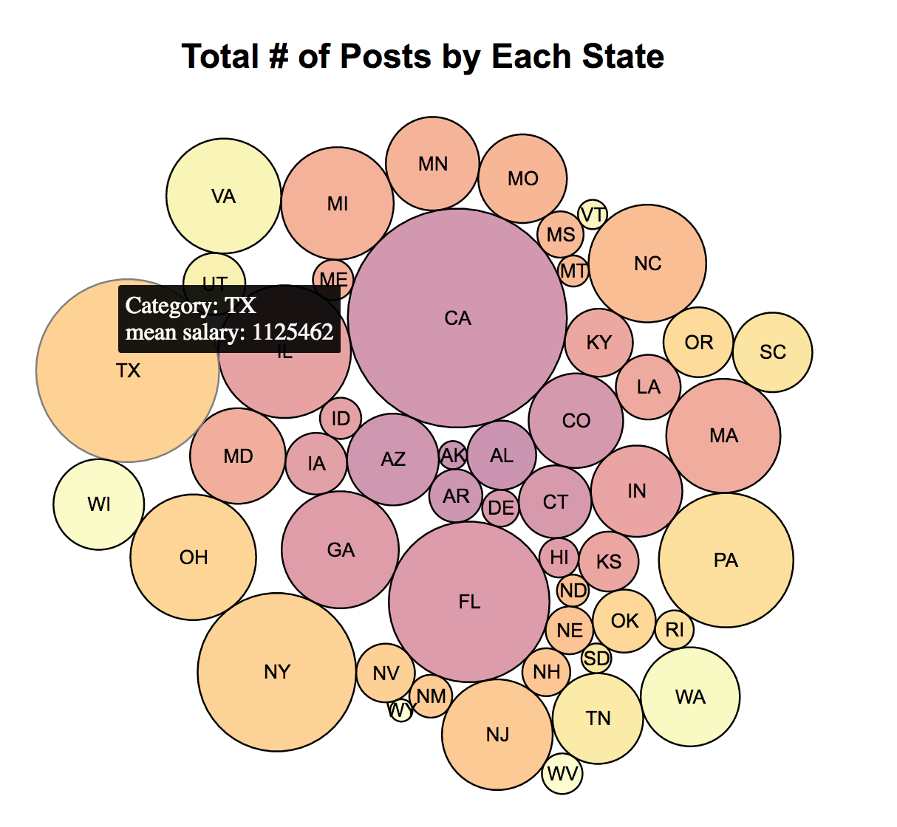
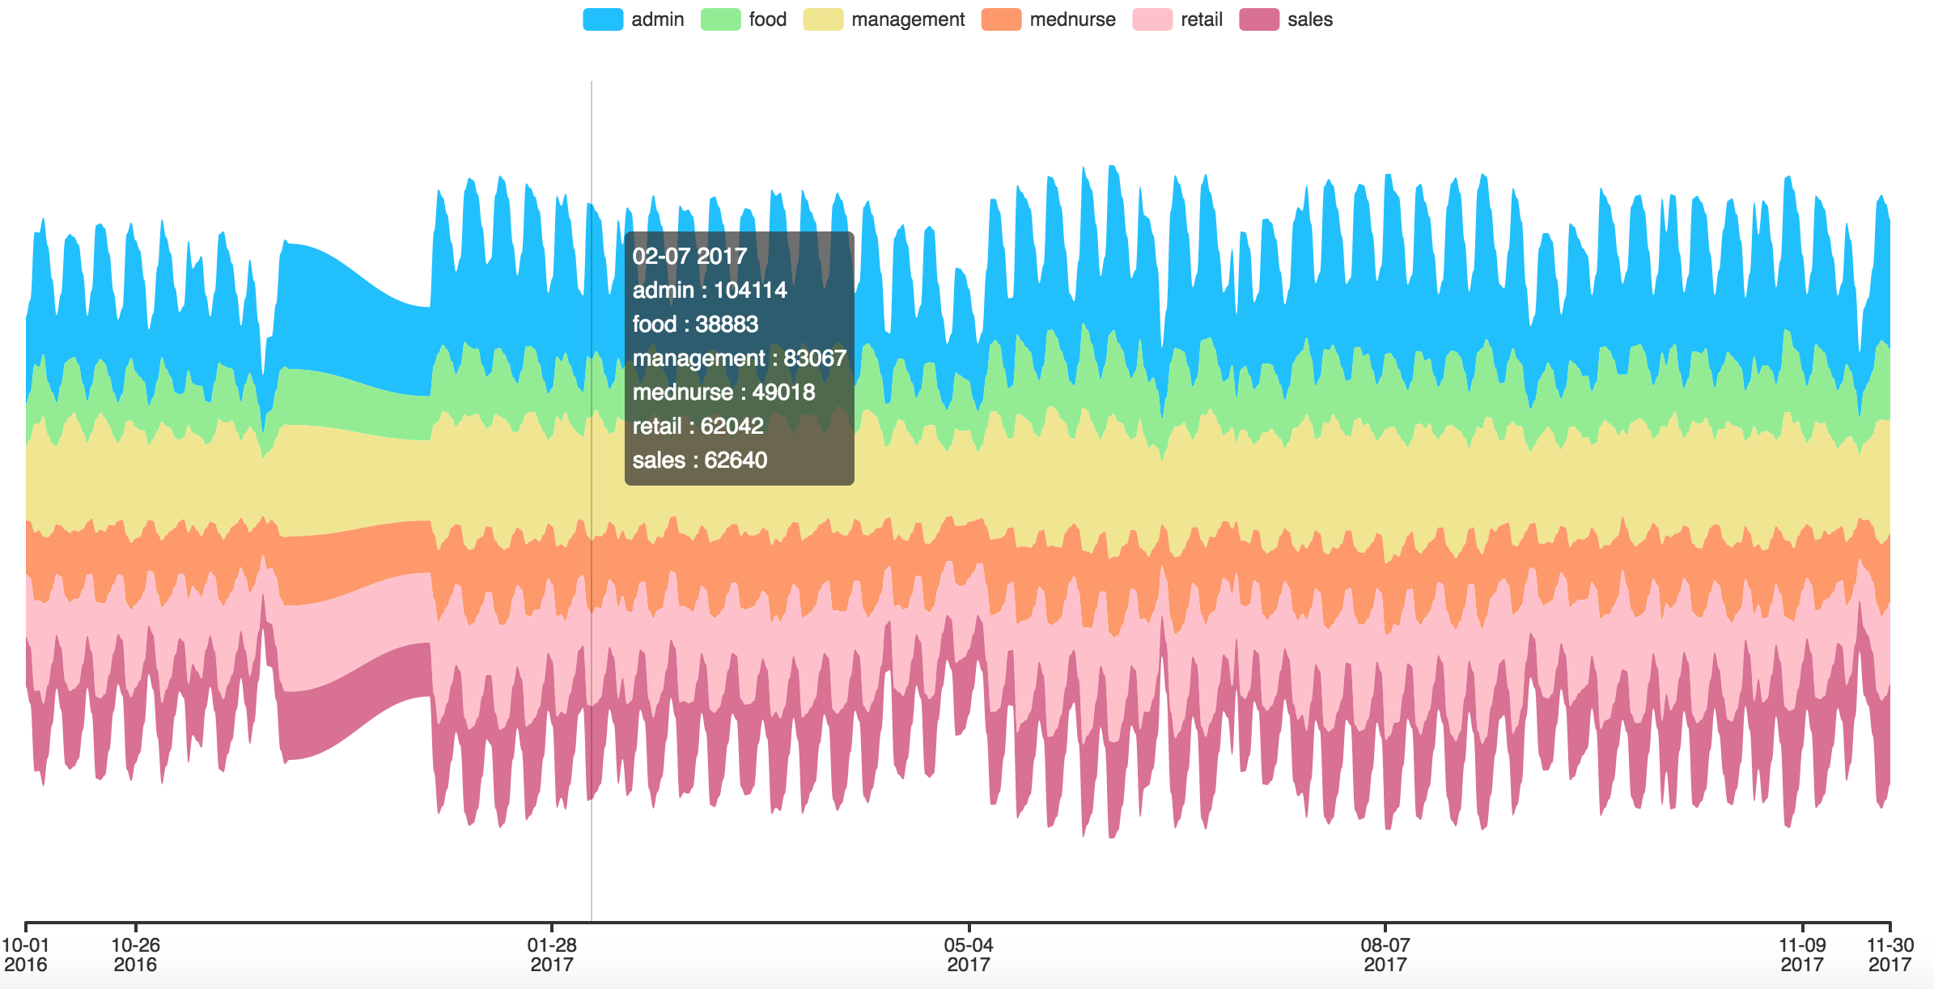
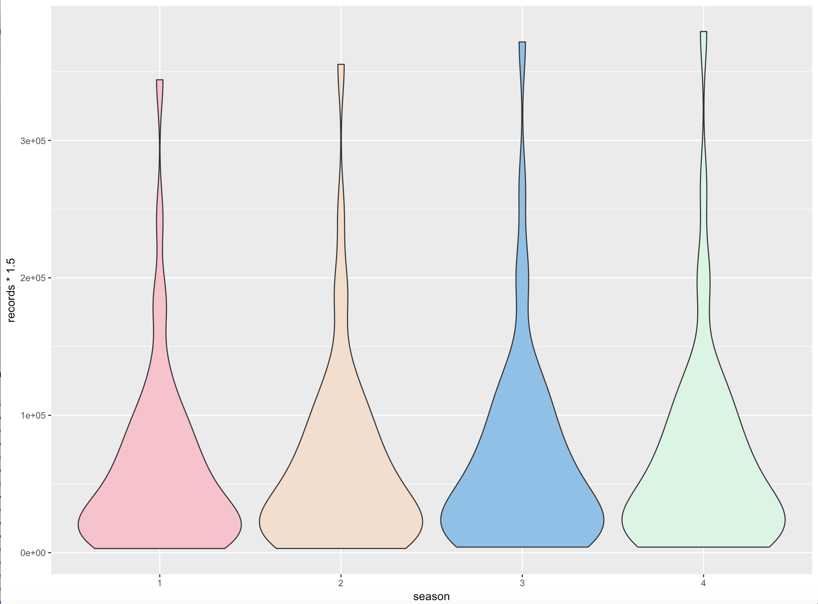
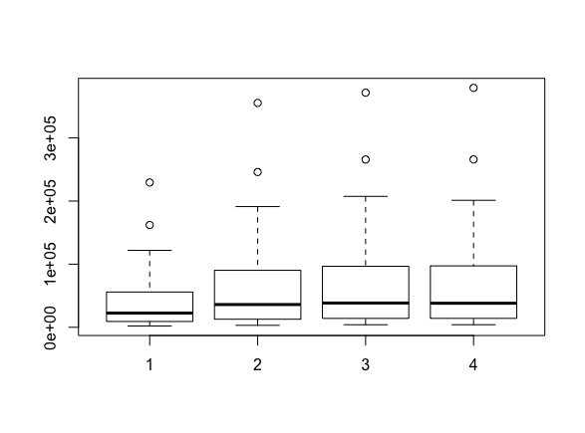
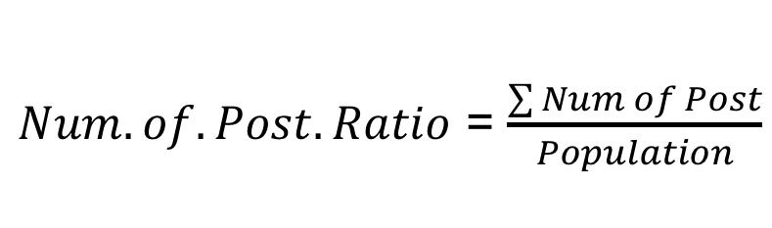
$Num.of.Post.Ratio$ = $\frac{\sum{Num of Post}}{Population}$

Slide 4
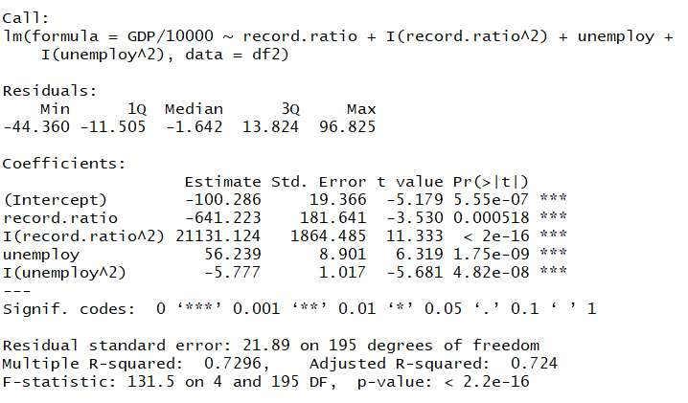

Model
GDP ~ Record.ratio + ${\text{Record}\text{.}\text{ratio}}^{2}$ + Unemployment + ${\text{Une}mployment}^{2}$

Slide 5
Thank You !

